Slide 1
Crypto Currency Dashboard

Slide 2

Introduction to
Cryptocurrency
Cryptocurrency:
A cryptocurrency is a digital or virtual currency that uses cryptography for security.
This makes it nearly impossible to counterfeit or double-spend.
Many cryptocurrencies operate on decentralized networks based on blockchain technology, which is a distributed ledger enforced by a network of computers.
Project Overview:
This project involves the analysis of various types of cryptocurrency over different years.
Dataset Link:
Cryptocurrency Price History Dataset

Slide 3
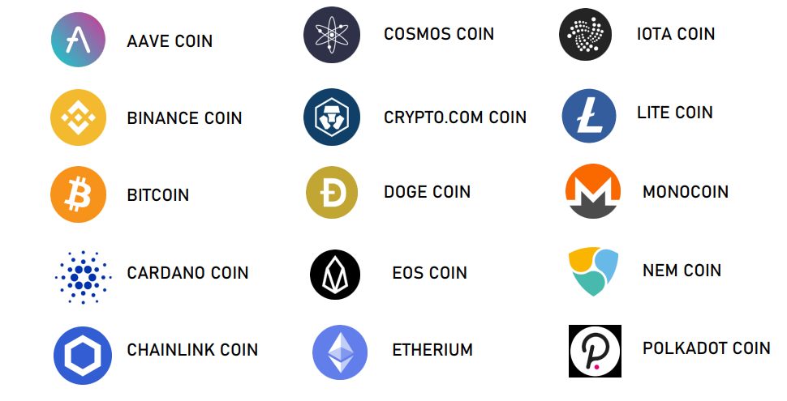
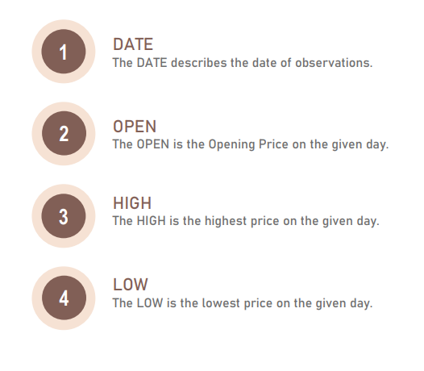
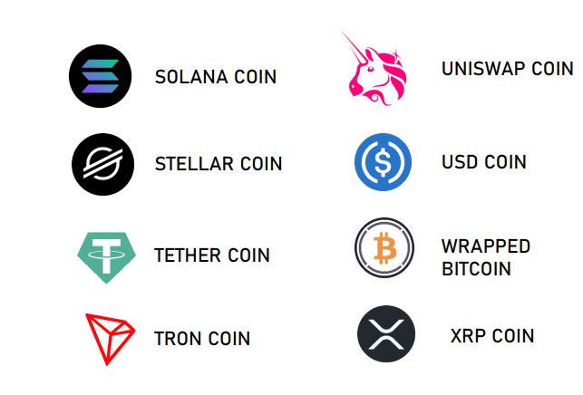
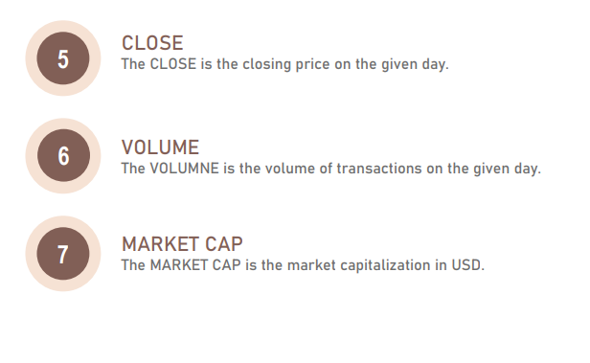
About the Dataset

Slide 4
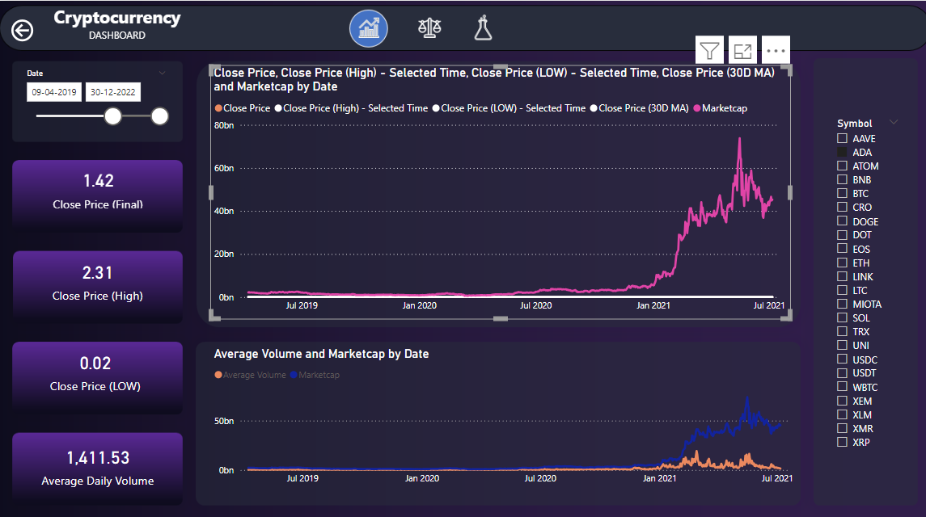
Overall Analysis
UNIT - I
1.How does the total market capitalization of a specific cryptocurrency evolve over time, and how does it compare to the cumulative market capitalization of all cryptocurrencies over the same period?

Slide 5
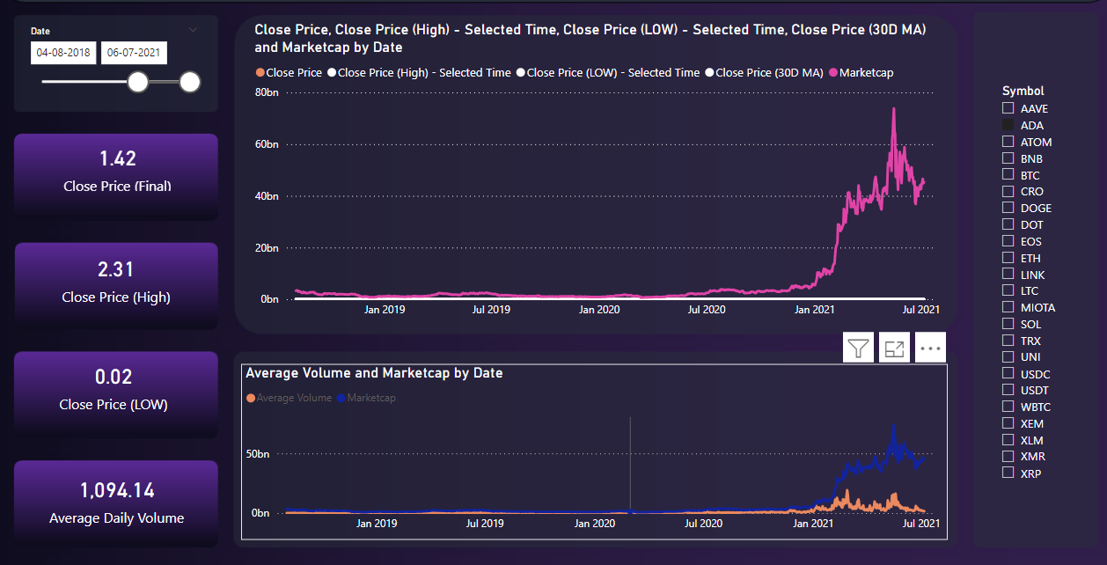
Overall Analysis
UNIT - I
2. What is the correlation between the market capitalization and volume for the top 10 cryptocurrencies by market cap, and how does it change over a specific time frame?

Slide 6
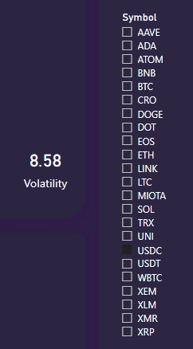
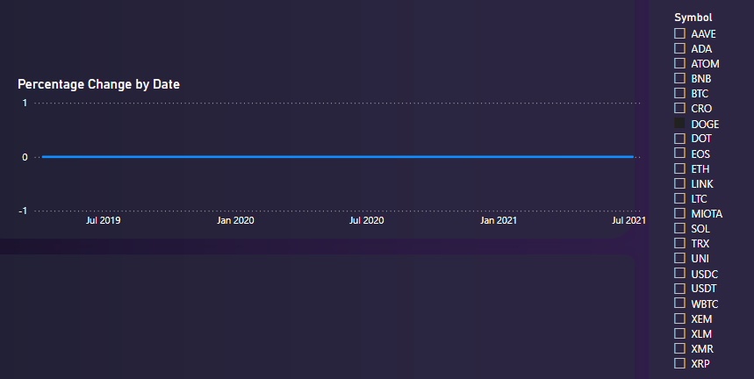
Overall Analysis
UNIT - II
3. How can you create a calculated column to determine the volatility of a cryptocurrency based on the daily price difference (high - low) and rank them by their volatility?
4. Create a DAX measure that calculates the percentage change in closing price for a cryptocurrency over a custom date range and compare it with another cryptocurrency.

Slide 7
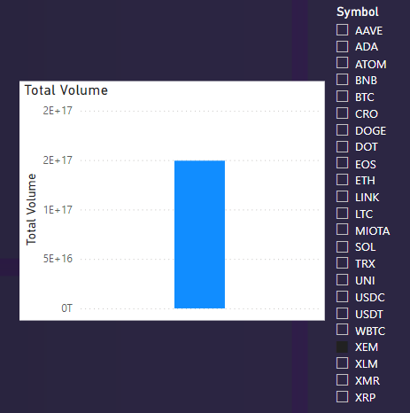
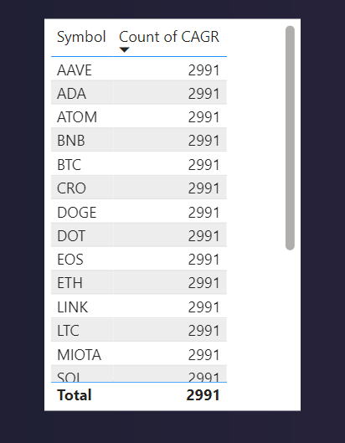
Overall Analysis
UNIT - II
5. What is the compounded annual growth rate (CAGR) of closing prices for top 5 cryptocurrencies, and how does it compare over different time periods (e.g., 1 year, 5 years)?
6. How can you create a simple DAX measure to calculate the total trading volume for a cryptocurrency?

Slide 8
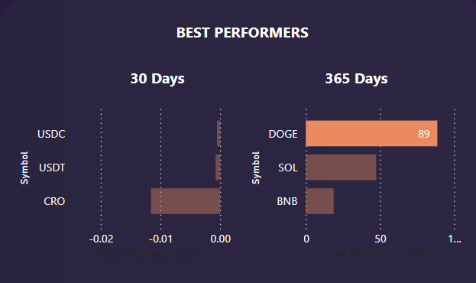
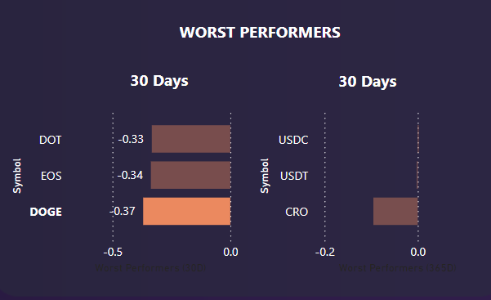
Overall Analysis
UNIT - III
7.Which cryptocurrencies are the best performers in terms of percentage change in closing price over the last 30 and 365 days?
8.Which cryptocurrencies are the worst performers in terms of percentage change in closing price over the 30 and 365 days?

Slide 9
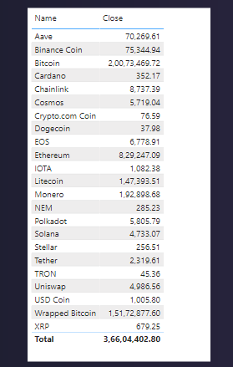
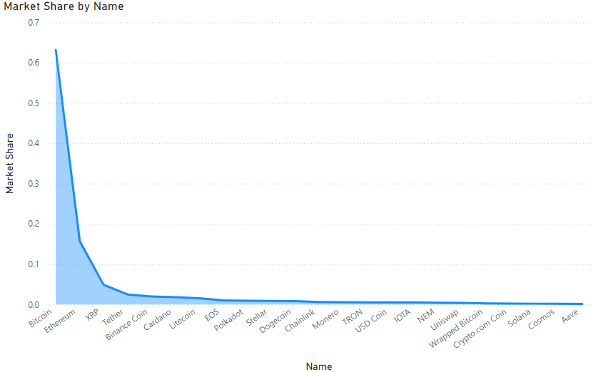
Overall Analysis
UNIT - III
9.What is the distribution of closing prices among different cryptocurrencies, and how does this distribution compare when visualized on a table?
10.How does the market share of a cryptocurrency (based on market capitalization) change relative to other cryptocurrencies, and how can it be visualized using a stacked area chart?

Slide 10
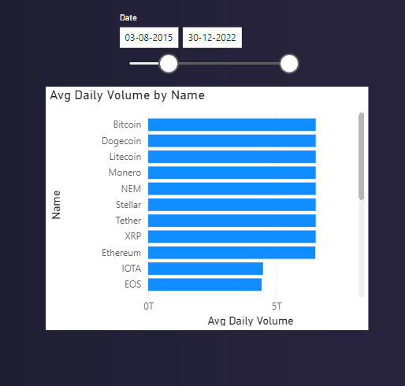
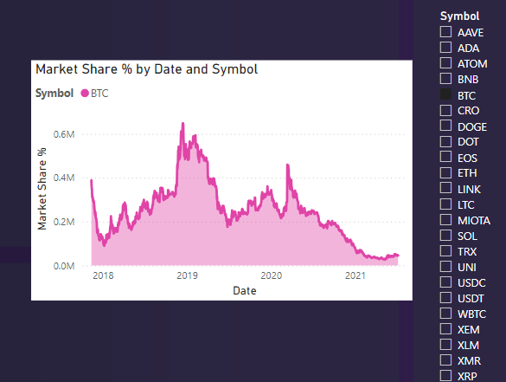
Overall Analysis
UNIT - IV
11.How can you create a Power Pivot model to compare the average daily trading volume across different cryptocurrencies and visualize this in a bar chart with the ability to filter by date range?
12.How does the market share of a cryptocurrency (based on market capitalization) change relative to other cryptocurrencies, and how can it be visualized using a stacked area chart?

Slide 11
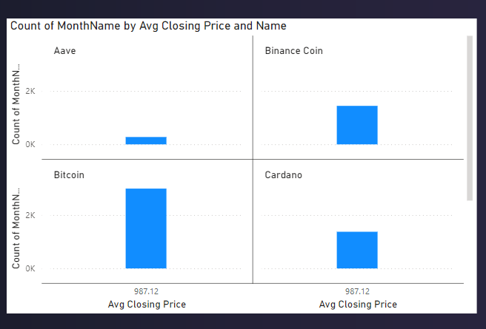
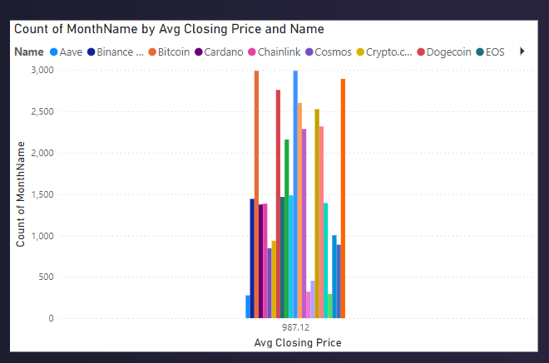
Overall Analysis
UNIT - IV
13. How can you create a clustered bar chart to compare the average closing price of each cryptocurrency during different months of the year and analyze any seasonal patterns?

Slide 12
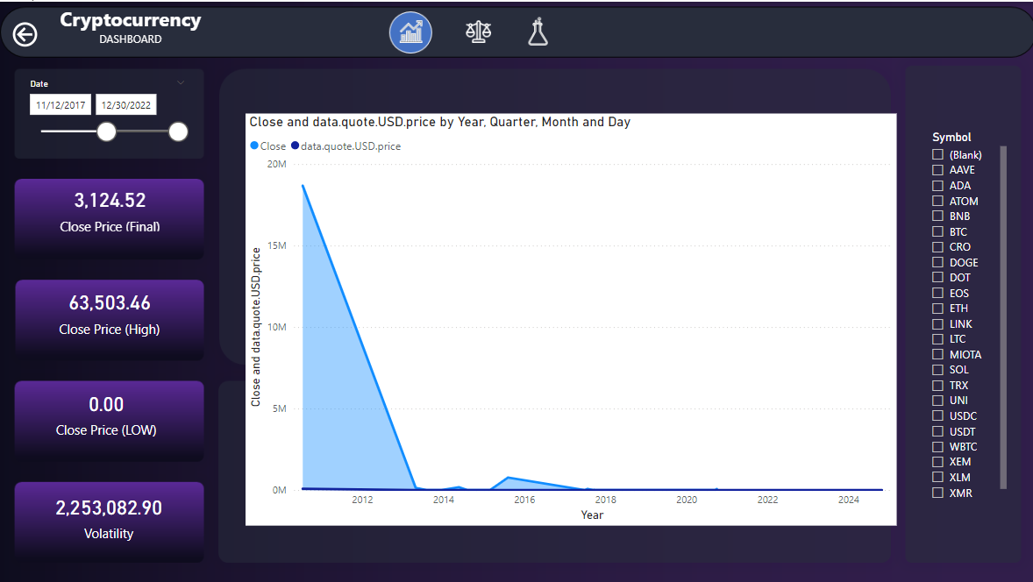
Overall Analysis
UNIT - V
14.How can you use API data to track and visualize the changing price of a cryptocurrency over time in Power BI?

Slide 13
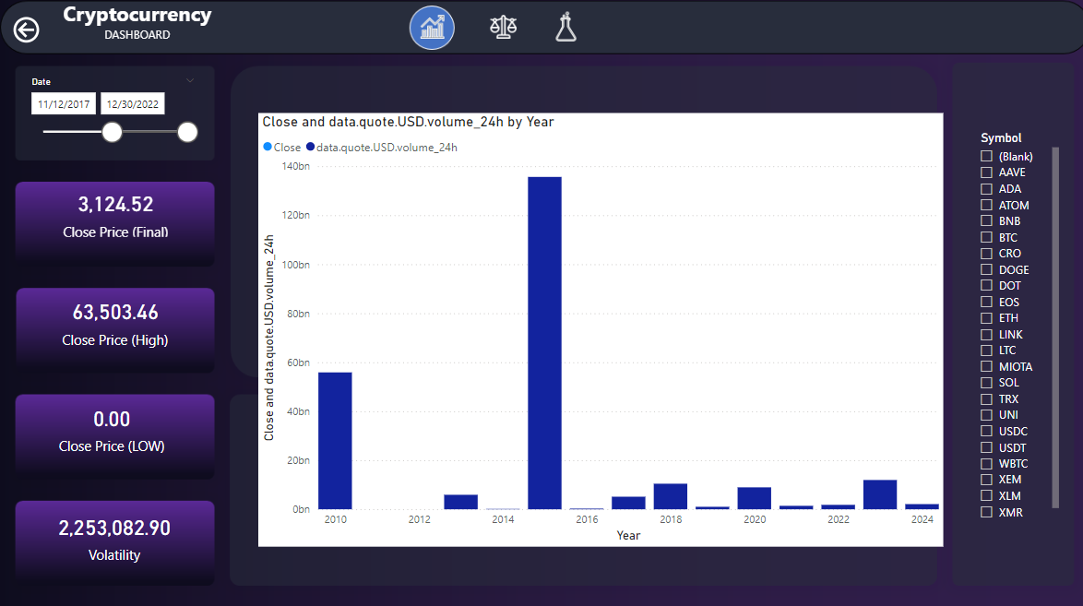
Overall Analysis
UNIT - V
15.How can you use API data to create a chart that displays the 24-hour trading volume trends of a cryptocurrency across different years?

Slide 14
Thank You

